Slide 1
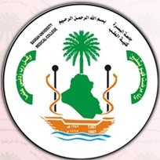
Motor System Lecture 3&4
Mustafa Al-Badran
CABM FIBMS
College of Medicine\ University of Basrah

Slide 2
Lecture 3 motor cortex Objectives
What is motor cortex
Main Motor cortex areas
Some specialized areas of motor cortex

Slide 3
Motor Cortex
Is the region of the cerebral cortex involved in the
Planning
Control
Execution
of voluntary movements
University of Basrah-College of Medicine-Physiology Department

Slide 4
Motor Cortex
Located anterior to the central cortical sulcus, occupying approximately the posterior one third of the frontal lobes
It divided in to 3 Areas
Primary Motor Cortex
Premotor Area
Supplementary Motor Area
Each has its own topographical representation of muscle groups and specific motor functions of the body
University of Basrah-College of Medicine-Physiology Department

Slide 5
University of Basrah-College of Medicine-Physiology Department

Slide 6
Primary Motor Cortex
Lies in the first convolution of the frontal lobes anterior to the central sulcus
Topographical representations of the different muscle areas of the body in the primary motor cortex
University of Basrah-College of Medicine-Physiology Department

Slide 7
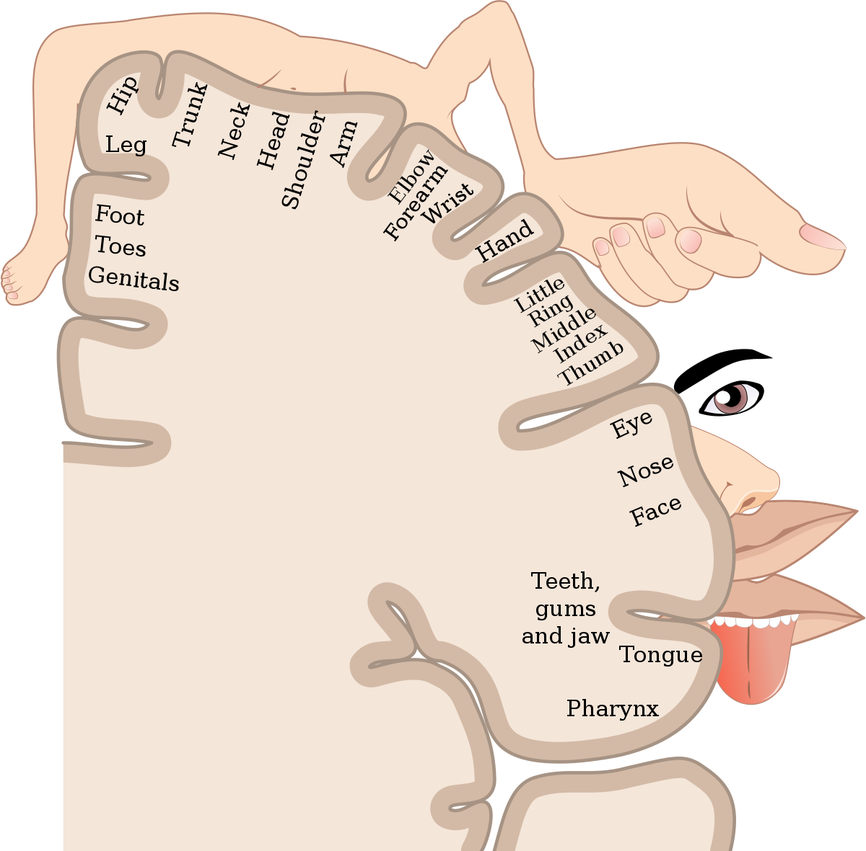
University of Basrah-College of Medicine-Physiology Department

Slide 8
Note that more than one half of the entire primary motor cortex is concerned with controlling the muscles of the hands and the muscles of speech
Excitation of a single motor cortex neuron usually excites a specific movement rather than one specific muscle
University of Basrah-College of Medicine-Physiology Department

Slide 9
Premotor Area
Lies 1 to 3 centimeters anterior to the primary motor cortex
University of Basrah-College of Medicine-Physiology Department

Slide 10
University of Basrah-College of Medicine-Physiology Department

Slide 11
The topographical organization of the premotor cortex is roughly the same as that of the primary motor cortex, with the mouth and face areas located most laterally
University of Basrah-College of Medicine-Physiology Department

Slide 12
Nerve signals generated in the premotor area cause much more complex “patterns” of movement than the that generated in the primary motor cortex
For instance, the pattern may be to position the shoulders and arms so that the hands are properly oriented to perform specific tasks
University of Basrah-College of Medicine-Physiology Department

Slide 13
Supplementary Motor Area
It extends a few centimeters onto the superior frontal cortex
The supplementary motor area has yet another topographical organization for the control of motor function
University of Basrah-College of Medicine-Physiology Department
Notes:
The supplementary motor area (SMA), on the top or dorsal part of the cortex. Each neuron in the SMA may influence many muscles, many body parts, and both sides of the body. The map of the body in SMA is therefore extensively overlapping. SMA projects directly to the spinal cord and may play some direct role in the control of movement
because the SMA appears to control movement bilaterally, it may play a role in inter-manual coordination.
Yet others have suggested that, because of the direct projection of SMA to the spinal cord and because of its activity during simple movements, it may play a direct role in motor control rather than solely a high level role in planning sequences

Slide 14
University of Basrah-College of Medicine-Physiology Department

Slide 15
This area functions in concert with the premotor area to provide
Body-wide attitudinal movements
Fixation movements of the different segments of the body
Positional movements of the head and eyes
University of Basrah-College of Medicine-Physiology Department

Slide 16
Some Specialized Areas of Motor Cortex
Control specific motor functions
University of Basrah-College of Medicine-Physiology Department

Slide 17
Broca’s Area (Motor Speech Area)
It’s the site for expression of words by stimulating
simultaneously the
Laryngeal muscle
Respiratory muscles
Muscles of the mouth
Damage to this area → Motor Aphasia
Damage to this area does not prevent a person from vocalizing, but it does make it impossible for the person to speak whole words
University of Basrah-College of Medicine-Physiology Department

Slide 19
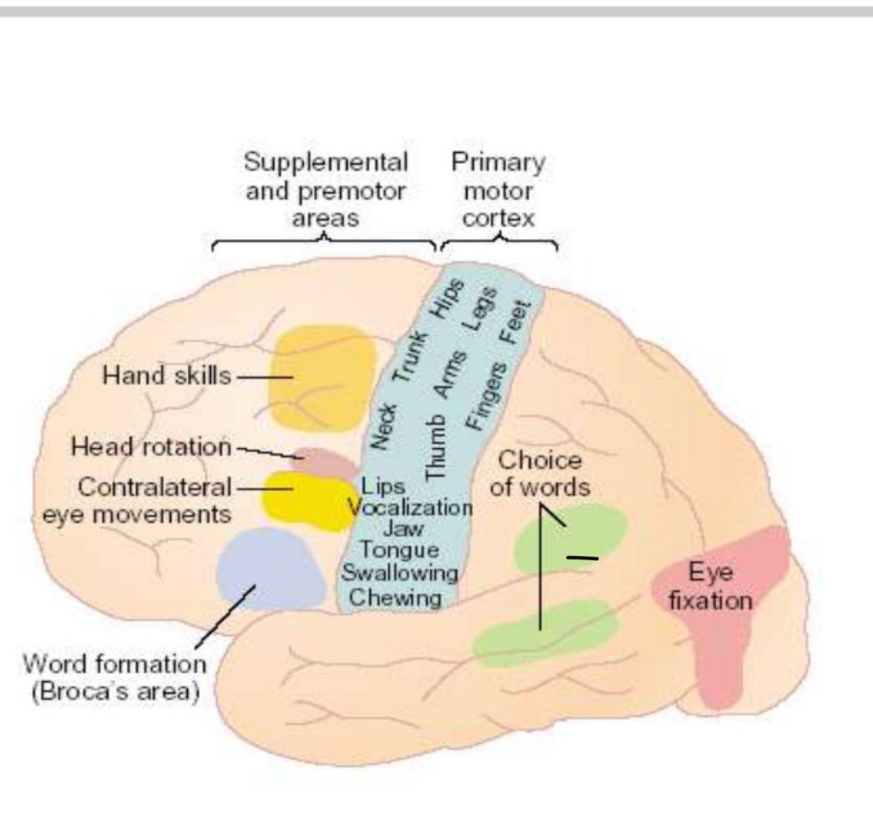
Voluntary Eye Movement Field
In the premotor area immediately above Broca’s area →a locus for controlling voluntary eye movements
Damage to this area prevents a person from voluntarily moving the eyes toward different objects
University of Basrah-College of Medicine-Physiology Department

Slide 20
Head Rotation Area
Its closely associated with eye movement field and related to directing the head toward different objects
University of Basrah-College of Medicine-Physiology Department

Slide 21
Area for Hand Skills
In the premotor area
Is a region that is important for “Hand skills”
Lesions cause destruction in this area, hand movements become uncoordinated and non purposeful, a condition called Motor Apraxia
University of Basrah-College of Medicine-Physiology Department

Slide 25
Recap
Motor cortex: Anterior to the central cortical sulcus, occupying approximately the posterior one third of the frontal lobes
Primary Motor Cortex
Premotor Area
Supplementary Motor Area
Broca’s Area (Motor Speech Area): expression of words
Voluntary” Eye Movement Field”: Controlling voluntary eye movements
Head rotation area: Eye movement field and related to directing the head
Area for hand skills (control hand movement)

Slide 27
Lecture 4 Transmission of Motor Signals Objectives
Direct: Pyramidal pathway
Indirect : Extrapyramidal Tract
Red Nucleus

Slide 28
Motor signals are transmitted
Directly from the cortex to the spinal cord through the corticospinal tract (Pyramidal)
Indirectly through multiple accessory pathways that involve
Basal ganglia
Cerebellum (Extrapyramidal)
Various Nuclei of the brain stem
University of Basrah-College of Medicine-Physiology Department

Slide 29
Corticospinal (Pyramidal) Tract
The most important output pathway from the motor cortex
Its makes about:
A 30 % from the primary motor cortex
A 30 % from the premotor and supplementary motor areas
A 40 % from the somatosensory areas posterior to the central sulcus
University of Basrah-College of Medicine-Physiology Department

Slide 30
Pyramidal Tract Fibers
Large fibers (3%)
16 μm in diameter
Originating from Betz cells
Faster conduction (70m/sec)
Ends directly in the α motor neuron
Other fibers (97%)
4μm in diameter
Slower conduction
Synapse with interneurons which in turn synapse with α or γ motor neuron
University of Basrah-College of Medicine-Physiology Department

Slide 31
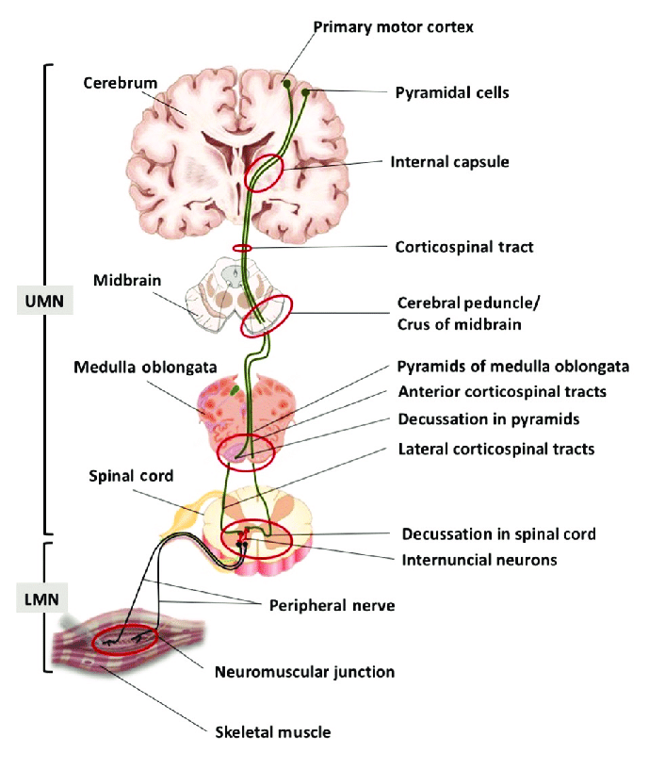

Slide 33
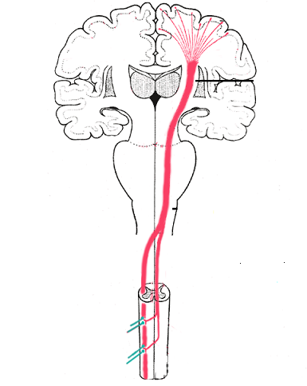
The majority of the pyramidal fibers then cross in the lower medulla to the opposite side and descend into the lateral corticospinal tracts of the cord, finally terminating principally on the interneurons in the intermediate regions of the cord gray matter
University of Basrah-College of Medicine-Physiology Department

Slide 34
A few of the fibers do not cross to the opposite side in the medulla but pass ipsilaterally down the cord in the (ventral or anterior corticospinal tracts)
Many, if not most, of these fibers eventually cross to the opposite side of the cord either in the neck or in the upper thoracic region
University of Basrah-College of Medicine-Physiology Department

Slide 35
Extrapyramidal System
All descending tracts other than the pyramidal tract called extrapyramidal tracts
Pyramidal and extrapyramidal tracts should function together for smooth activity
Background tone, Posture, Equilibrium etc., are maintained by extrapyramidal system
Voluntary activity is controlled by pyramidal system
University of Basrah-College of Medicine-Physiology Department
Notes:
Muscle tone is traditionally defined as 'the tension in the relaxed muscle' or 'the resistance, felt by the examiner during passive stretching of a joint when the muscles are at rest
Muscle tone (residual muscle tension or tonus) is the continuous and passive partial muscles contraction

Slide 36
Extrapyramidal Fibers Arise From
Subcortical Structures
Cerebral Cortex
Basal Ganglia
Reticular Formation Of Brain Stem
Vestibular Nuclei
Red Nucleus
Tectal Nucleus
Olivary Nucleus
University of Basrah-College of Medicine-Physiology Department

Slide 37
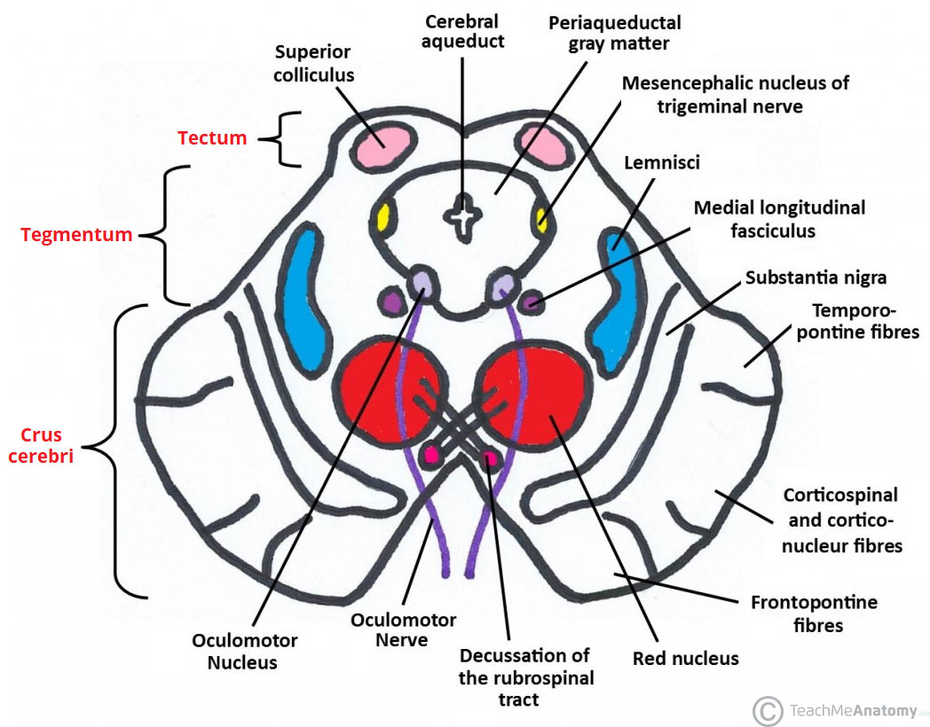
Red Nucleus
University of Basrah-College of Medicine-Physiology Department

Slide 38
THE RED NUCLEUS
Structure in the rostral midbrain involved in motor coordination
Serves as an Alternative Pathway for Transmitting Cortical Signals to The Spinal Cord
University of Basrah-College of Medicine-Physiology Department

Slide 39
Corticorubrospinal
Fibres from primary motor cortex synapse with large neurons in magnocellular portion of red nucleus → Corticorubral Tract
Fibres from red nucleus to spinal cord → Rubrospinal Tract Which crosses to the opposite side in the lower brain stem and follows a course immediately adjacent and anterior to the corticospinal tract
University of Basrah-College of Medicine-Physiology Department

Slide 40
University of Basrah-College of Medicine-Physiology Department

Slide 41
Functions of Corticorubrospinal Tract
It has a representation of all the muscles of the body, as is true of the motor cortex
The representation of the different muscles is far less developed than in the motor cortex (it is relatively small in human beings)
The Corticorubrospinal pathway serves as an accessory route for transmission of signals from the motor cortex to the spinal cord
University of Basrah-College of Medicine-Physiology Department

Slide 42
When the corticospinal fibres are destroyed but the Corticorubrospinal pathway is intact
Discrete movements can still occur, except that the movements for fine control of the fingers and hands are considerably impaired
University of Basrah-College of Medicine-Physiology Department

Slide 43
Recap
1.Pathways of Motor transmission
2.Corticospinal Tract
3.Red Nucleus
Few of the fibers do not cross to the opposite side in the medulla but pass ipsilateral down the cord in the (ventral or anterior corticospinal tracts)
The majority will cross in the lower medulla to the opposite side and descend into the lateral corticospinal tracts of the cord, terminating on the interneurons in the intermediate regions of the cord gray matter
Structure in the rostral midbrain involved in motor coordination, transmission of discrete signals from the motor cortex to the spinal cord.
Direct :Pyramidal
Indirect :Extrapyramidal

